Slide 1
ALAT
A new authoring environment for GALE
Notes:
Thank everyone for coming.
Result of 6m project
If not explained: explain format of defense.

Slide 2
The project context
Introduction to Adaptive Hypermedia
Related work
ALAT
Future work
Conclusions
ALAT: A new authoring environment

Slide 3


The project context
Collaboration between TU/e and “De Roode Kikker”.
TU/e goal: An improved authoring environment and a real-life application of GALE.
“De Roode Kikker” goal: Add adaptivity to existing
e-learning platform.
Opportunity for me: Creating a new authoring environment.
ALAT: A new authoring environment
Notes:
Combining resources/specialities
Name goals of both parties
Opportunity taken because: Meetings for fresh ideas, multiple disciplines

Slide 4
What is Adaptive Hypermedia?
Adaptivity:
“The state or quality of being adaptive; capacity to adapt.”
Hypermedia:
“An extension of the term hypertext, is a nonlinear medium of information which includes graphics, audio, video, plain text and hyperlinks.”
ALAT: A new authoring environment
Notes:
Hypermedia: aka: “Stuff we can see and interact with in our internet browsers.
So: Browser content which adapts to a user specifically.
Adaptive Hypermedia is about adapting content to the user, rather than a 1 size fits all solution for all users.

Slide 5
Adapt what?
Hide/show links or information
Text
Images
Video
Exercises
Questionnaires
Etc.
Recommendations through hyperlink adaptation
Whatever you can think of!
ALAT: A new authoring environment
Notes:
Whatever you can think of in terms of personalization in web applications

Slide 6
Adapt to what?
Previously visited pages
Number of page visits
Time spent visiting pages
Test results
User profile
ALAT: A new authoring environment
Notes:
User profile can be filled in by the adaptive system itself (like nr times visited or time spent on a page, questionnaire/excersise results)
Or externally from some other available data source

Slide 7
How does this work?
Adaptive Hypermedia Systems
GALE (Generic Adaptation Language & Engine)
GRAPPLE project
A web server which performs adaptivity
Adaptive applications
ALAT: A new authoring environment
Notes:
GALE is the TU/e standard adaptive hypermedia platform.
Developed in GRAPPLE project. Collaboration with European partners both industrial and academic. 2008 to 2011
Gale runs “adaptive applications”

Slide 8
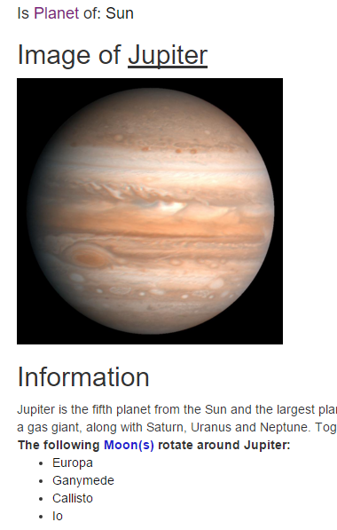
Adaptive applications
Domain model (DM)
Concepts
Attributes & Parameters
Non-pedagogical relations
Adaptation model (AM)
Adaptation rules
GAM code
Unary (Visited counter)
Binary (Prerequisite)
ALAT: A new authoring environment
Notes:
Adaptive applications consist out of DM + AM.
Name examples of DM items, Att/params: name, web resource, category.
Non-pedagogical rules: parent/child or functional: Moon rotatesAround earth. (used in gale layouts to create hierarchy or lists for example)
AM.
Snippet comes from demo, developed earlier by a masters student. I redeveloped it using ALAT. Will show this in live demo

Slide 9
Authoring
“The Achilles heel of Adaptive Hypermedia”
Complicated
increase in complexity as more flexibility in adaptivity is introduced
Tedious
Might hinder widespread uptake
ALAT: A new authoring environment
Notes:
Complicated: Rules are in code very technical. Large applications become unmanageable.
Tedious: Lot of repeated behavior. This results in a lot of dumb labor.

Slide 10
The solution: Authoring Tools
ALAT: A new authoring environment
Notes:
Take away complexity from the user. Makes designing easier. Generate applications based on design.

Slide 11
The current tool for GALE: GAT
GRAPPLE Authoring Tool
Also developed during GRAPPLE project
Created by multiple parties
Unfortunate design decisions
ALAT: A new authoring environment
Notes:
Current authoring tool for GALE
Some unfortunate design decisions taken due to multiple project partners

Slide 12
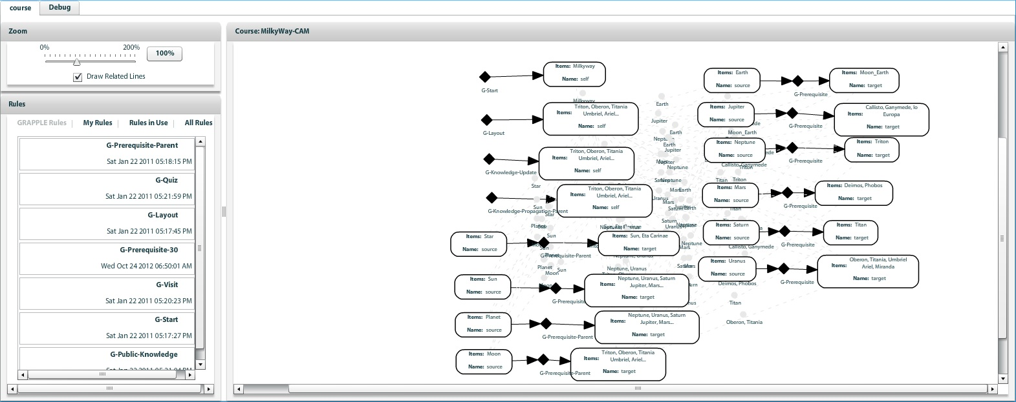
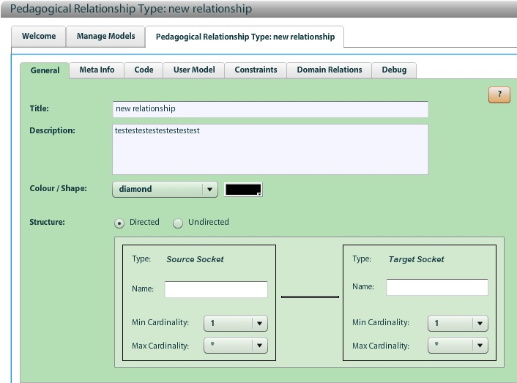
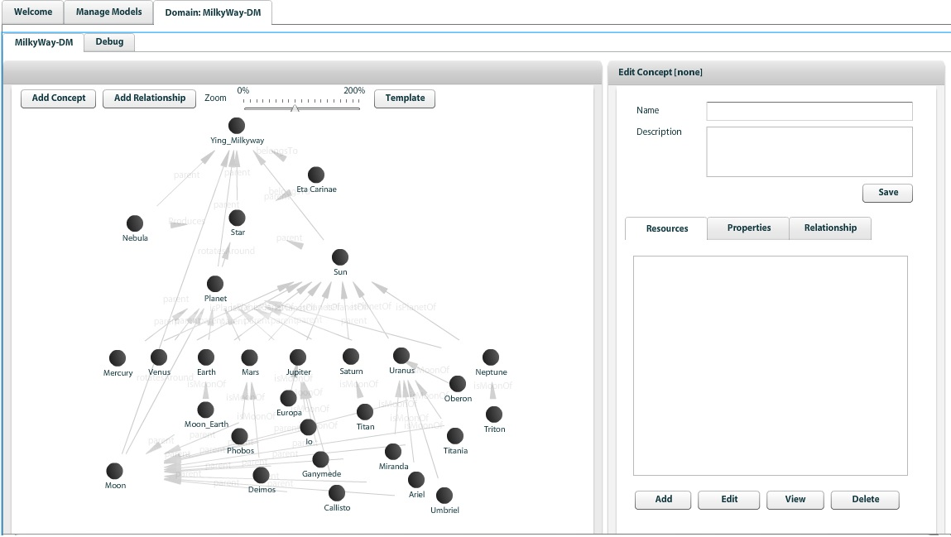
3 tools in 1
ALAT: A new authoring environment
Notes:
3 tools: DM, AM, new rules. Context switching is a big issue.

Slide 13
Domain designer tool
ALAT: A new authoring environment
Notes:
DM design:
Cluttered interface.
Clumsy controls.
Information divided over lots of screens.
Adding concepts and relations involves various pop up windows
selection boxes when adding relations contain huge lists.

Slide 14
Course designer tool
ALAT: A new authoring environment
Notes:
AM design.
Graph interface seems impractical.
If domain changes, other tool is needed
Big lists when selecting.
Cluttered, graph does not make a lot of sense
Way of thinking. First Rule, then concepts -> STRANGE

Slide 15
Pedagogic Relation tool
ALAT: A new authoring environment
Notes:
- Make new adaptation rules.
Actually pretty useful for advanced users
No easy lookup, copy/paste from existing rules. Is this really better than editing configuration files?
Conclude GAM discussion

Slide 16
Other related work
ALAT: A new authoring environment
Notes:
A look at other state of the art tools to discover what these tools do different
More tools in thesis, but 2 selected to show today.

Slide 17
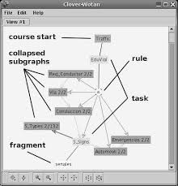
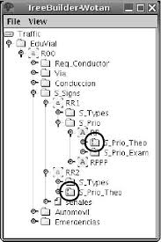
WOTAN
(Freire & Rodriguez, University of Madrid 2005)
ALAT: A new authoring environment
Notes:
WOTAN background
Graph interface attempt.
Complicated interface design
DM + AM in 1 model causes for redundant information/interface cluttering
Lesson: separation of concerns is important, Graph interfaces are extremely difficult to properly use

Slide 18
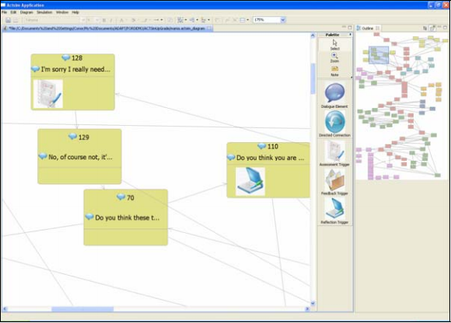
ACTsim
(Gaffney, Dagger, Wade, Trinity College Dublin 2010)
ALAT: A new authoring environment
Notes:
Soft skills emulation made adaptive
Educational simulations. Limited scope
Easy to use
Lesson: Tradeoff Genericity – Service/usability

Slide 19
ALAT
“Adaptive Learning Authoring Tool”
Generic
Easy
Fast
ALAT: A new authoring environment
Notes:
Main features I will be discussing: The interface design/ application workflow AND the extensive templating which makes it so generic.

Slide 20
Genericity through templating
Concept blueprints
Relation definitions
JSON files server side
ALAT: A new authoring environment
Notes:
Great strength of ALAT is templating.
All rules / concept blueprints from templates.
JSON format for easy read/write and native parsing.

Slide 21
Concept blueprints
Introduces standard behavior
Rules
Attributes
Default attributes
ALAT: A new authoring environment
Notes:
Gives new concepts standard behavior: Rules and attributes.
ALSO defines attributes over all concept types (used for layouts in GALE.)
prevents having to declare them for every concept.

Slide 22
{ "defaultAttributes":[ { "name":"suitability", "type":"Boolean", "value":"true" }, { "name":"knowledge", "type":"Double", "value":"0", "operator":"AVG" } ], "conceptTypes":[ { "name":"text-topic", "default_attributes":[ { "name":"info", "type":"String", "value":"This is some basic concept information text!" } ], "default_rules":[ "own knowledge update", "visited", "knowledge_update" ] } ] }
ALAT: A new authoring environment
Notes:
Explain attributes and objects.
Note this does not contain rule definitions
ALL concepts have default attributes
Concepts of concept type contains which additional rules/attributes it has. Rules will result in more attributes (defined by these rules)

Slide 23
Relation definitions
Contains all Pedagogical relation definitions
Adaptation rules on default attributes
Adaptation rules on other attributes
Default non-pedagogical relations
reusable
Tooltips for usability
ALAT: A new authoring environment

Slide 24
{
"def_att_rules":[ { "name":"hasPrerequisite", "type":"binary", "target":"suitability", "tooltip":"Target concept must be learned before source is recommended.", "code":"${%target%#knowledge} > 0.8", "operator":"and" } ], "persistent_att_rules":[ { "name":"visited", "type":"unary", "properties":[ { "name":"visited", "type":"Integer", "defval":"" } ], "tooltip":"stores number of concept visits in ‘visited’", "code":"#[visited]:Integer event +`if (${#suitability}) { ${#visited}++;}`" } ], "def_relations":[ { "name":“isMoonOf", "tooltip":"source concept is a moon of the target object." } ] }
ALAT: A new authoring environment
Notes:
Relation definitions template
Def rules Volatile -> code calculated value when required
Pers rules persistent -> Only attribute updates are calculated (attribute stored in user profile automatically by GALE)

Slide 25
Interface and workings – Live Demo
ALAT: A new authoring environment
Notes:
Cannot show everything…..
Will show some things it does better than GAT.
Think per concept
Hierarchical parent-child structure (can also be used by GALE layout)
All concept settings in one screen
DM + AM in 1 tool.

Slide 26
Future work
More Showcase applications
Real world usability testing
Concept Blueprints & rule sets
Research projects:
Introduce support for different learning styles.
limited version for non-technical experts.
Try to make a graph interface work.
ALAT: A new authoring environment
Notes:
ALAT is meant to be new GALE platform
Learning styles in AH have been researched at TU/e, introduce them to alat!
Due to roode kikker connection: create a version usable by teachers.
Testing will probably conclude an easier version is needed. Refer to ACTSim
HTI maybe? Can we make a graph-like interface work in authoring at all?

Slide 27
Conclusions
A new authoring platform
Easy
Fast
Generic
ALAT: A new authoring environment
Notes:
I hope ALAT will become an authoring platform with both real-world as well as academic applications. I also hope it will set a new standard for authoring in GALE and that it will bring many opportunities for future research and development in the field of AH and GALE.

Slide 28
Q&A!
ALAT: A new authoring environment

